Slide 1

STATS 432 Computational Statistics
Tutorial 6 – Convergence Diagnostics & Gibbs Sampling

Slide 2

Convergence Diagnostics

Slide 3

Question 1 :
Question 1
Consider the continuous random variable X defined by the probability density function…
$$f_{X}\left(x\right) = \left\{\begin{matrix}\frac{1}{18} x^{2} +\frac{1}{6} & if & x∈[0,3] \\ 0 & if & x∉[0,3]\end{matrix}\right.$$
Create a function in R which uses a uniform random walk proposal density within theMetropolis-Hastings algorithm to produce a sequence of observations drawn from the above distribution. Your function must have the following arguments…
MetHat <- function(n, start, proposal_width)
… where
n defines the number of observations to be drawn
start defines the starting position of the chain
proposal_width defines the width of the uniform proposal density.
See Section 1 of the code
3
Associated code = Tutorial 6 - Q1 to Q3

Slide 4
Question 2:
Question 2
Run the algorithm you produced in Question 1 with the parameters…
burnin <- 1000 # Length of burn-in mcmc <- 9000 # Length of post-burn-in chain set.seed(12345) MH_Output <- Met_Hat( n = burnin + mcmc, start = 1.5, proposal_width = 0.15)
See Section 2 of the code
# 2.1a - Define burn-in and number of elements of the chain to use after the burn-in has occurred. > burnin <- 1000 > mcmc <- 9000
# 2.1b - Running the function / macro defined in the previous section. Results are saved in a list object called MH_Output > set.seed(12345) > delta = 0.15 > MH_Output <- MetHat(n = burnin + mcmc, start = 1.5, proposal_width = delta)
4
Associated code = Tutorial 6 - Q1 to Q3

Slide 5
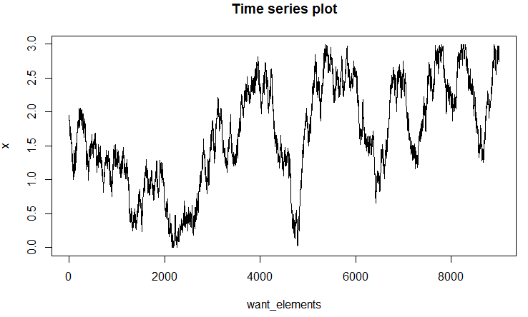
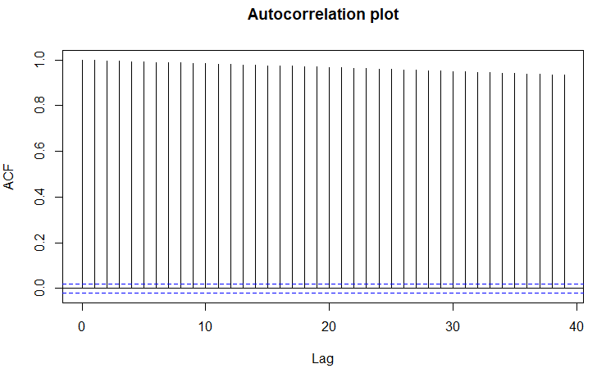

Question 2:
Question 2
See Section 3 of the code
Calculate the acceptance rate of the chain.
Acceptance rate = 0.9813
Construct a time series plot of the post-burn-in elements of the chain.
Construct an autocorrelation plot of the post-burn-in elements of the chain.
Convert the post-burn-in elements of the chain to an ‘mcmc’ object and obtain basic summary statistics.
E[X] and Var[X] can be calculated analytically as... E[X] = 1.875
Var[X] = 0.684375 => SD[X] = 0.8273
5
Associated code = Tutorial 6 - Q1 to Q3

Slide 6
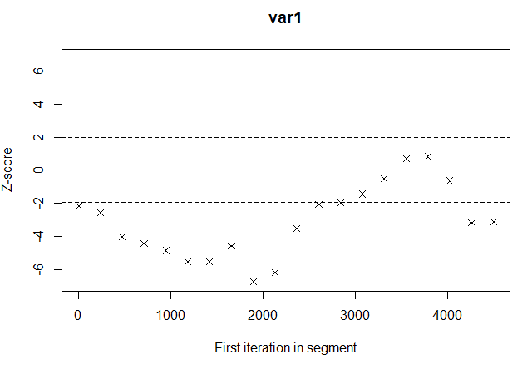
Question 2:
Question 2
See Section 4 of the code
Conduct a Geweke Time Series Diagnostic test on the post-burn-in elements of the chain and construct the associated Geweke plot.
# 4.1a - Performing the Geweke test
> geweke.diag(post_burn0)
# 4.1b - Creating Geweke plots
> geweke.plot(post_burn0)
Fraction in 1st window = 0.1
Fraction in 2nd window = 0.5
var1
-2.174
Z-score for the Geweke diganostic is greater than 2 in absolute value. => Evidence against the null hypothesis that the values in the two windows are from the same distribution.
Geweke plot function calculates the value of the Geweke Diagnostic with successively more and more points removed from the beginning of the chain. Vast majority of test statistics have z-scores outside the interval [-2,2] suggesting that chain values inside the first and second windows do not arise from the same distribution. However, the fact that the Geweke plot seems to trend into the interval [-2,2] suggests that a longer burn-in and overall chain length may be enough for the chain to converge.
6
Associated code = Tutorial 6 - Q1 to Q3

Slide 7
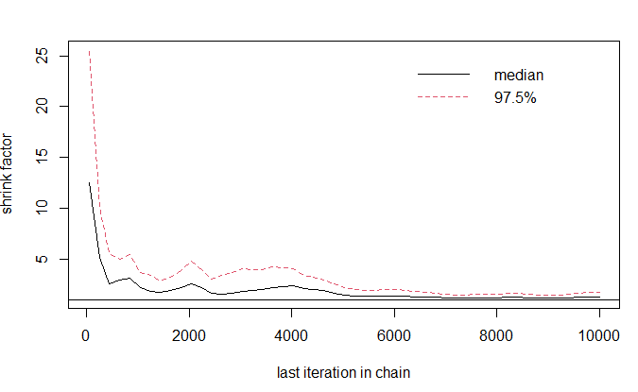
Question 2:
Question 2
See Section 5 of the code
Conduct a Gelman & Rubin Multiple Sequence Diagnostic Test using four separate chains with starting values 0, 1, 2 & 3. Obtain the associated Gelman & Rubin plot.
# 5.1c - Conducting the Gelman & Rubin multiple sequence diagnostic test > gelman.diag(gel_rub_list)
# 5.1d - Producing Gelman-Rubin plot > gelman.plot(gel_rub_list)
Potential scale reduction factors:
Point est. Upper C.I.
1.29 1.73
Both the point and upper estimate of the PSRF are in excess of 1.2. This suggests that the chain has not converged to the target distribution.
7
Associated code = Tutorial 6 - Q1 to Q3

Slide 8
Question 2:
Question 2
See Section 6 of the code
Perform the Heidelberger & Welch Diagnostic test for convergence.
# 6.1a - Converting the original MH_Output$x chain to an mcmc object (Heidelberger & Welch test must be run on the whole chain)
> heidelchain <- mcmc(MH_Output$x)
# 6.1b - Conducting the Heidelberger & Welch diagnostic test
> heidel.diag(heidelchain, eps = 0.1, pvalue = 0.05)
Stationarity start p-value
test iteration
var1 passed 1 0.435
Halfwidth Mean Halfwidth
test
Var1 failed 1.76 0.533
Chain passes the Stationarity Test but fails the Halfwidth Test.
This suggests that the chain has not converged to the target distribution.
Based on the answers to the above, what do you conclude?
The chain fails the Geweke Diagnostic, the Gelman & Rubin Diagnostic and the Heidelberger & Welch Diagnostic. We therefore have a lot of evidence to suggest that the chain has not converged to the target distribution.
The chain has a very high acceptance rate and is mixing too slowly because the width of the proposal density is too small.
8
Associated code = Tutorial 6 - Q1 to Q3

Slide 9
Question 3:
Question 3
Run the algorithm you produced in Question 1 with the parameters…
burnin <- 1000 # Length of burn-in mcmc <- 9000 # Length of post-burn-in chain set.seed(12345) MH_Output <- Met_Hat( n = burnin + mcmc, start = 1.5, proposal_width = 4.5)
See Section 2 of the code
# 2.1a - Define burn-in and number of elements of the chain to use after the burn-in has occurred. > burnin <- 1000 > mcmc <- 9000
# 2.1b - Running the function / macro defined in the previous section. Results are saved in a list object called MH_Output > set.seed(12345) > delta = 4.5 > MH_Output <- MetHat(n = burnin + mcmc, start = 1.5, proposal_width = delta)
9
Associated code = Tutorial 6 - Q1 to Q3

Slide 10
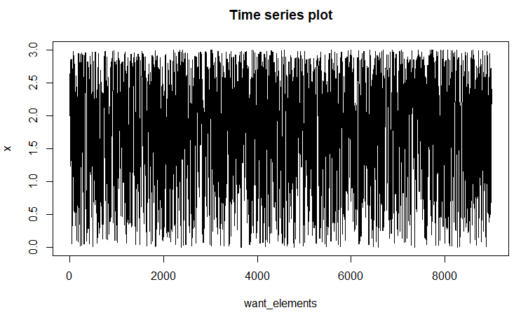
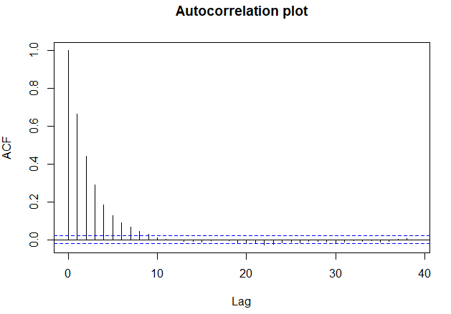

Question 3:
Question 3
See Section 3 of the code
Calculate the acceptance rate of the chain.
Acceptance rate = 0.4815
Construct a time series plot of the post-burn-in elements of the chain.
Construct an autocorrelation plot of the post-burn-in elements of the chain.
Convert the post-burn-in elements of the chain to an ‘mcmc’ object and obtain basic summary statistics.
E[X] and Var[X] can be calculated analytically as... E[X] = 1.875
Var[X] = 0.684375 => SD[X] = 0.8273
10
Associated code = Tutorial 6 - Q1 to Q3

Slide 11
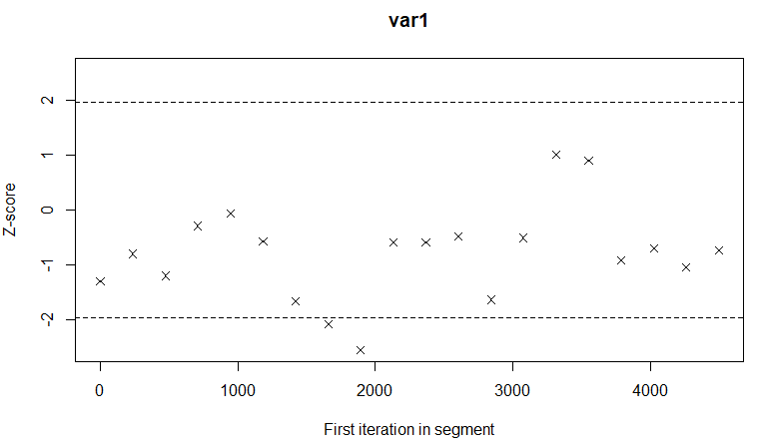
Question 3:
Question 3
See Section 4 of the code
Conduct a Geweke Time Series Diagnostic test on the post-burn-in elements of the chain and construct the associated Geweke plot.
# 4.1a - Performing the Geweke test
> geweke.diag(post_burn0)
# 4.1b - Creating Geweke plots
> geweke.plot(post_burn0)
Fraction in 1st window = 0.1
Fraction in 2nd window = 0.5
var1
-1.301
Z-score for the Geweke diganostic is less than 2 in absolute value. => No evidence against the null hypothesis that the values in the two windows are from the same distribution.
Geweke plot function calculates the value of the Geweke Diagnostic with successively more and more points removed from the beginning of the chain. Vast majority of test statistics have z-scores inside the interval [-2,2]. No evidence that the chain has not converged to the target distribution.
11
Associated code = Tutorial 6 - Q1 to Q3

Slide 12
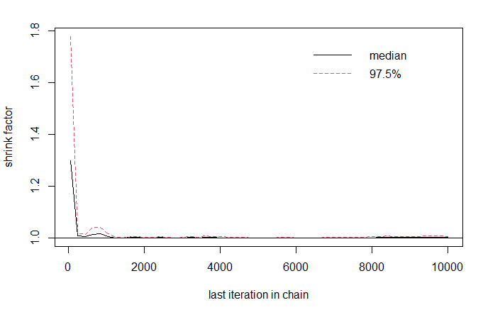
Question 3:
Question 3
See Section 5 of the code
Conduct a Gelman & Rubin Multiple Sequence Diagnostic Test using four separate chains with starting values 0, 1, 2 & 3. Obtain the associated Gelman & Rubin plot.
# 5.1c - Conducting the Gelman & Rubin multiple sequence diagnostic test > gelman.diag(gel_rub_list)
# 5.1d - Producing Gelman-Rubin plot > gelman.plot(gel_rub_list)
Potential scale reduction factors:
Point est. Upper C.I.
1 1.01
Both the point and upper estimate of the PSRF are less than 1.2. => No evidence that the chain has not converged to the target distribution.
12
Associated code = Tutorial 6 - Q1 to Q3

Slide 13
Question 3:
Question 3
See Section 6 of the code
Perform the Heidelberger & Welch Diagnostic test for convergence.
# 6.1a - Converting the original MH_Output$x chain to an mcmc object (Heidelberger & Welch test must be run on the whole chain)
> heidelchain <- mcmc(MH_Output$x)
# 6.1b - Conducting the Heidelberger & Welch diagnostic test
> heidel.diag(heidelchain, eps = 0.1, pvalue = 0.05)
Stationarity start p-value
test iteration
var1 passed 1 0.391
Halfwidth Mean Halfwidth
test
Var1 passed 1.85 0.0364
Chain passes both the Stationarity Test and the Halfwidth Test.
No evidence that the chain has not converged to the target distribution.
Based on the answers to the above, can we definitively conclude that the chain has converged to its target distribution?
The chain passes the Geweke Diagnostic, the Gelman & Rubin Diagnostic and the Heidelberger & Welch Diagnostic. It exhibits good mixing and there is low correlation between values of the chain for high lag values. However, we still cannot say with 100% certainty that the chain has converged.
13
Associated code = Tutorial 6 - Q1 to Q3

Slide 14
Gibbs Sampling
Example on page 79 of the Course Notes

Slide 15
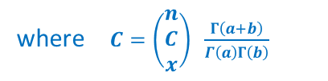
Question 4:
Question 4
Consider the random variable $θ \sim Beta(a,b)$ which has the following probability density function
$$f_{θ}\left(θ\right) = \left\{\begin{matrix}\frac{Γ(a+b)}{Γ\left(a\right)Γ(b)} θ^{ a−1} {\left(1 −θ\right)}^{b−1} & if & θ∈[0,1] \\ 0 & if & θ∉[0,1]\end{matrix} \right.$$
Also consider the random variable $X | θ \sim Bin(n, θ)$ which has probability density function
$$f_{ X|θ} (x | θ)= \left(\begin{matrix}n \\ C \\ x\end{matrix}\right)θ^{x} {\left(1 −θ\right)}^{n−x}$$
This gives rise to the joint distribution
$$f_{X,θ} \left(x, θ\right) = f_{ X|θ} (x | θ) f_{θ}\left(θ\right) = \left(\begin{matrix}n \\ C \\ x\end{matrix}\right) \frac{Γ\left(a+b\right)}{Γ\left(a\right)Γ\left(b\right)} θ^{x+a−1} {\left(1 −θ\right)}^{n − x + b − 1}$$
To derive the conditional distribution $f_{ θ|X} (θ | x)$ we pick out all the terms in the joint distribution that involve $θ$ and treat all the terms involving $x$ as a constant. In this way we obtain
where $C=\left(\begin{matrix}n \\ C \\ x\end{matrix}\right) \frac{Γ\left(a+b\right)}{Γ\left(a\right)Γ\left(b\right)}$
$$f_{ θ|X} (θ | x) = C θ^{x+a−1} {\left(1 −θ\right)}^{n − x + b − 1}$$
i.e. $θ | X \sim Beta( x+a, n −x+b)$
15
Associated code = Tutorial 6 – Q4

Slide 16
Question 4:
Question 4
Given that the conditional distributions $X | θ \sim Bin(n, θ)$ and $θ | X \sim Beta( x+a, n −x+b )$ are known and easy to sample from, create a function in R that uses the method of Gibbs sampling to obtain a sequence of observations drawn from the joint probability density function
$$f_{X,θ} \left(x, θ\right) = f_{ X|θ} (x | θ) f_{θ}\left(θ\right) = \left(\begin{matrix}n \\ C \\ x\end{matrix}\right) \frac{Γ\left(a+b\right)}{Γ\left(a\right)Γ\left(b\right)} θ^{x+a−1} {\left(1 −θ\right)}^{n − x + b − 1}$$
Your function must contain the following arguments…
Gibbs_Algorithm <- function(niterations, n, a, b)
… where ‘niterations’ is the length of the chain to be produced, ‘n’ is the parameter of the binomial distribution and a & b are the parameters of the $Beta(a,b)$ distribution.
See Section 1 of the code.
16
Associated code = Tutorial 6 – Q4

Slide 17
Question 4:
Question 4
Run your code with the parameters
burnin <- 1000 # Length of burn-in mcmc <- 9000 # Length of post-burn-in chain set.seed(12345) Gibbs_Result <- Gibbs_Algorithm(niterations = burnin + mcmc, n = 15, a = 3, b = 7)
See Section 2.1a – 2.1b of the code.
Produce time series plots, autocorrelation plots and histograms of the variables $X$ and $θ$ separately.
See Section 2.1c – 2.1g of the code.
17
Associated code = Tutorial 6 – Q4

Slide 18
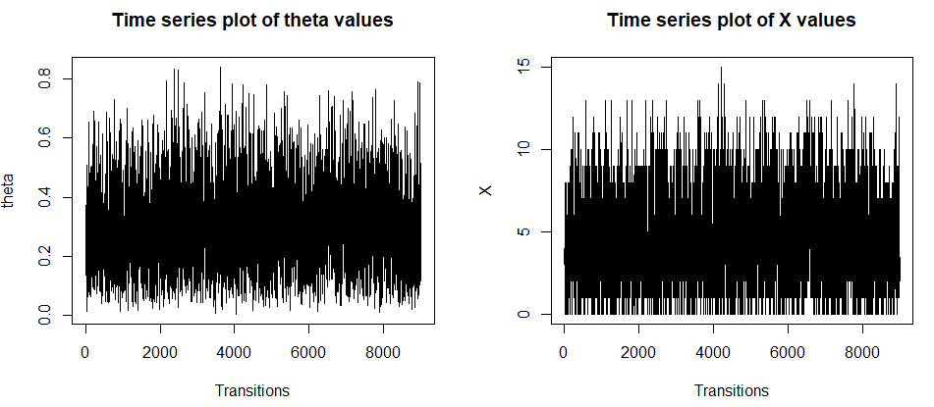
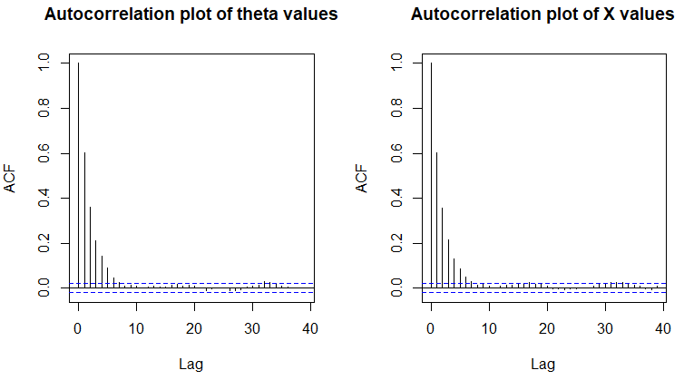
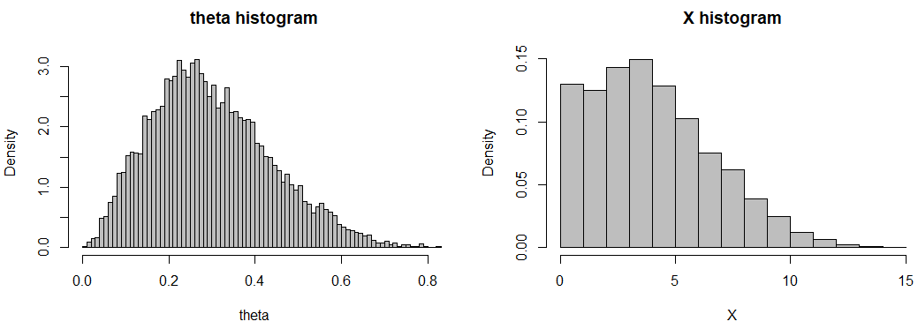
Question 4:
Question 4
18
Associated code = Tutorial 6 – Q4

